Slide 1
INTRODUCTION
TOPIC: PRESENTATION PROJECT-INSURANCE CLAIM
GROUP-1
P HARIKRISHNA NAIDU
Shreyas M S
Prashant Patil
Abhay S
Vidya Sagar
Abin
Chandra Sekhar Bongani

Slide 2
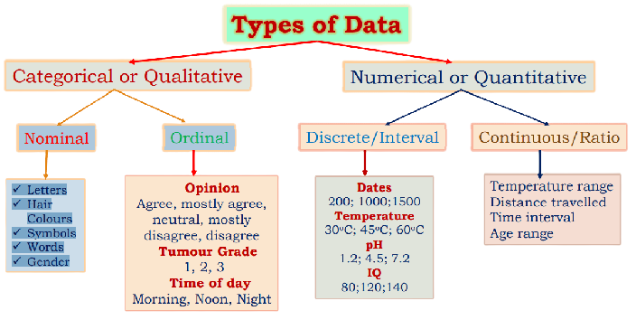
TYPES OF DATA

Slide 3
CATEGORICAL AND CONTINUOUS VARIABLES FROM THE GIVEN DATASET
a. Identify the categorical and continuous variables
CATEGORICAL VARIABLES
(ITS HAVE MOSTELY NAMES OR LABLES)
SEX
REGION
SMOKER

Slide 4
CATEGORICAL AND CONTINUOUS VARIABLES FROM THE GIVEN DATASET
CONTINUOUS VARIABLES
(NUMBERD VALUES THAT ARE MEASURED, AND NUMBER WITHIN A PARTICULAR RANGE)
BMI{BODY MASS INDEX}
CHARGES
DISCRETE VARIABLES
(IT ONLY TAKE CERTAIN VALUES)
AGE & CHILDREN

Slide 5
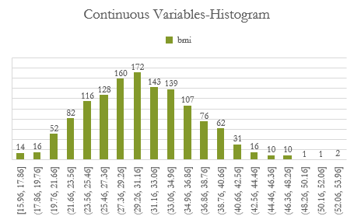
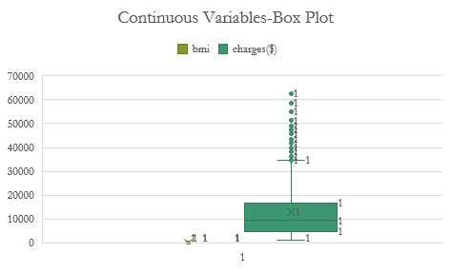
HISTOGRAMS AND BOX PLOTS b. Make Histograms and box plots for continuous variables, do a correlation analysis.

Slide 6
CORRELATION ANALYSIS
DATA ANALYSIS FUNCTION IS USED FOR CORRELATION OF CONTINUOUS VARIABLES
CORRELATION ANALYSIS
 | bmi | charges($)
bmi | 1
charges($) | 0.198341 | 1

Slide 7
PIVOT TABLES AND CHARTS c. Make relevant Pivot tables and charts for :
I . Male/Female ratio and which gender has more smokers
THE MALE GENDER HAVE MORE SMOKERS THAN FEMALE GENDER.159 MALE SOMKERS AND 115 FEMALE SMOKERS
331:338
Count of smoker | smoker
sex | no | yes | Grand Total
female | 547 | 115 | 662
male | 517 | 159 | 676
Grand Total | 1064 | 274 | 1338

Slide 8
Charges vs Age ii. Charges vs Age
THIS IS THE GRAPH ABOUT CHARGES VS AGE

Slide 9
Charges vs BMI iii. Charges vs BMI
THIS IS THE GRAPH ABOUT Charges vs BMI

Slide 10
Charges for Smokers vs Non-smoker iv. Charges for Smokers vs Non-smoker
About, Charges for Smokers vs Non-smoker
smoker | Average of charges($)
no | 8434.268298
yes | 32050.23183
Grand Total | 13270.42227

Slide 11
v. Region-wise Smokers vs non-smokers "YES“ or “NO”

Slide 12
vi. Region-wise charges for smokers vs non-smokers

Slide 13
Vii .CHARGES GOT DEPENDANTS

Slide 14
viii. Do a similar dependants-charges analysis, Region-wise

Slide 15
ix. Do at least one more pivot table and chart of your own choice, if needed.

Slide 16
d. Give your understanding from the patterns observed in point (b)
Ans: Age is rightly skewed Positive highest observations(306)= 18-25 Age is correlated to charges by 0.299(closer to 0) Charges to least related to children Lowly related combination are bmi and children also children and charge

Slide 17
e. Give your interpretation for observations made in point ( c )
THE MALE GENDER HAVE MORE SMOKERS THAN FEMALE GENDER.159 MALE SOMKERS AND 115 FEMALE SMOKERS

Slide 18
Edited Data
2. Edit the data as following, to obtain dummy variables:
Sex : Replace all the “Males” with “1” and “Females” with “0”, creating numerical entries for gender this way will help you do analysis further. You can use Replace with “Match entire cell content option. Do a replace all to save time.
b. Smoker: Replace all the “Smokers” with “1” and “Non-smokers” with “0”.
c. Region: We always create one less category column for the dummy data w.r.t the categories available for that original variable. So for Region, we will create three dummy columns, assuming “Northeast” as zero and omit the column for it. Now create three columns for “northwest”, “Southeast”, “Southwest”. Whichever row has “northwest” region as an entry will take “1” as an entry otherwise “0” in “northwest” column. Similarly in “Southeast” column, which ever row had “southeast” as an entry will take “1” as the new entry and “0” for rest of the rows. Do a similar operation on “Southwest” column.

Slide 19
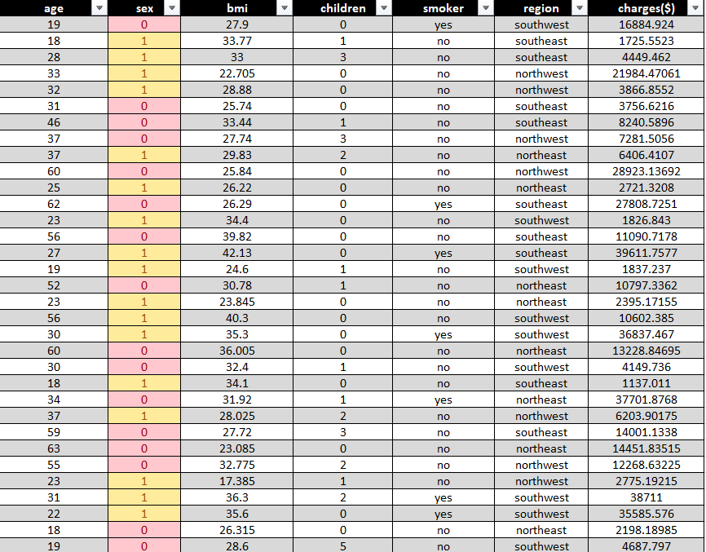
A: Replace all the “Males” with “1” and “Females” with “0

Slide 20
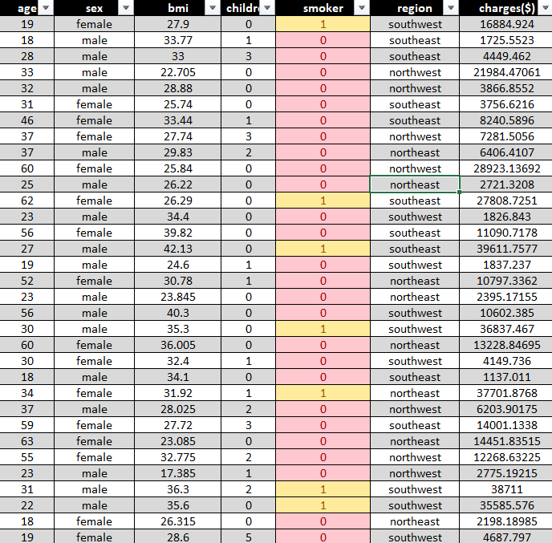
B: the “Smokers” with “1” and “Non-smokers” with “0”

Slide 21
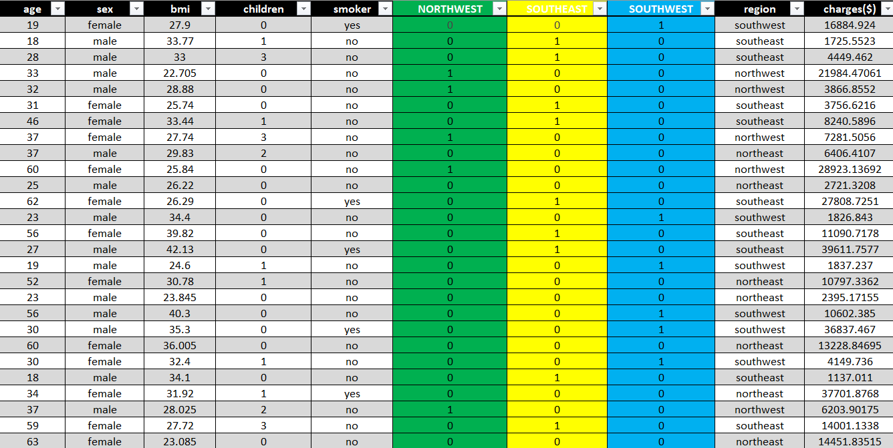
C: create three columns for “northwest”, “Southeast”, “Southwest”

Slide 22
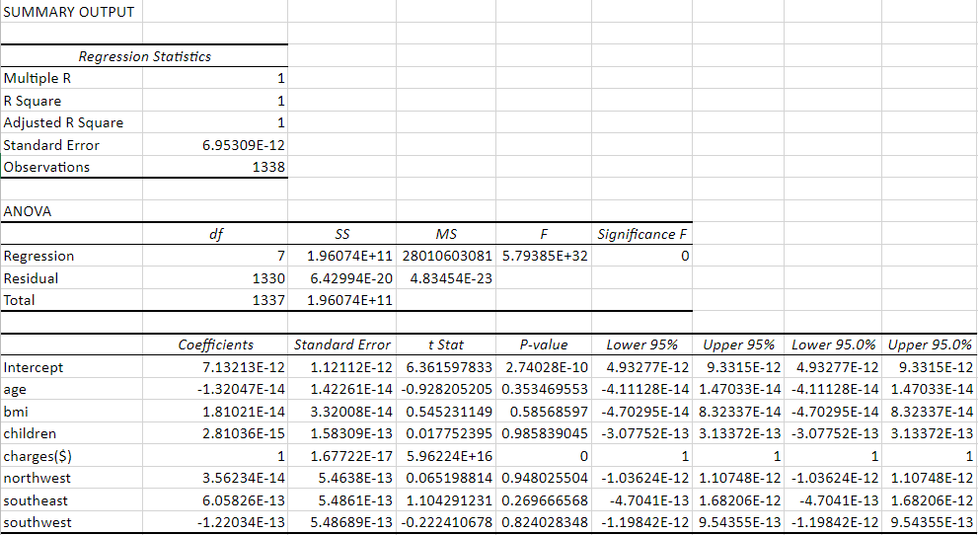
Multiple Linear Regression
3. Do a descriptive summary analysis for the edited data. Perform a Multiple Linear Regression analysis to identify which variables decide the insurance charges/billed insurance claim. Give your interpretation for the above analysis, do another set of regression analysis by dropping insignificant variables, if needed.

Slide 23
a descriptive summary analysis
Age |  | Sex |  | BMI |  | Children |  | Smoker |  | Charges($) |  | Northwest |  | Southeast |  | Southwest
Mean | 39.20702541 | Mean | 0.505231689 | Mean | 30.66339686 | Mean | 1.094917788 | Mean | 0.204783259 | Mean | 13270.42227 | Mean | 0.242899851 | Mean | 0.272047833 | Mean | 0.242899851
Standard Error | 0.384102419 | Standard Error | 0.013673526 | Standard Error | 0.166714232 | Standard Error | 0.032956155 | Standard Error | 0.01103632 | Standard Error | 331.0674543 | Standard Error | 0.011728017 | Standard Error | 0.012170498 | Standard Error | 0.011728017
Median | 39 | Median | 1 | Median | 30.4 | Median | 1 | Median | 0 | Median | 9382.033 | Median | 0 | Median | 0 | Median | 0
Mode | 18 | Mode | 1 | Mode | 32.3 | Mode | 0 | Mode | 0 | Mode | 1639.5631 | Mode | 0 | Mode | 0 | Mode | 0
Standard Deviation | 14.04996038 | Standard Deviation | 0.500159569 | Standard Deviation | 6.098186912 | Standard Deviation | 1.20549274 | Standard Deviation | 0.403694038 | Standard Deviation | 12110.01124 | Standard Deviation | 0.428995407 | Standard Deviation | 0.445180784 | Standard Deviation | 0.428995407
Sample Variance | 197.4013867 | Sample Variance | 0.250159595 | Sample Variance | 37.18788361 | Sample Variance | 1.453212746 | Sample Variance | 0.162968876 | Sample Variance | 146652372.2 | Sample Variance | 0.18403706 | Sample Variance | 0.19818593 | Sample Variance | 0.18403706
Kurtosis | -1.245087653 | Kurtosis | -2.002556636 | Kurtosis | -0.050731531 | Kurtosis | 0.202454147 | Kurtosis | 0.145755539 | Kurtosis | 1.606298653 | Kurtosis | -0.559856699 | Kurtosis | -0.949522817 | Kurtosis | -0.559856699
Skewness | 0.055672516 | Skewness | -0.020951397 | Skewness | 0.284047111 | Skewness | 0.93838044 | Skewness | 1.46476616 | Skewness | 1.515879658 | Skewness | 1.200409261 | Skewness | 1.025621147 | Skewness | 1.200409261
Range | 46 | Range | 1 | Range | 37.17 | Range | 5 | Range | 1 | Range | 62648.55411 | Range | 1 | Range | 1 | Range | 1
Minimum | 18 | Minimum | 0 | Minimum | 15.96 | Minimum | 0 | Minimum | 0 | Minimum | 1121.8739 | Minimum | 0 | Minimum | 0 | Minimum | 0
Maximum | 64 | Maximum | 1 | Maximum | 53.13 | Maximum | 5 | Maximum | 1 | Maximum | 63770.42801 | Maximum | 1 | Maximum | 1 | Maximum | 1
Sum | 52459 | Sum | 676 | Sum | 41027.625 | Sum | 1465 | Sum | 274 | Sum | 17755824.99 | Sum | 325 | Sum | 364 | Sum | 325
Count | 1338 | Count | 1338 | Count | 1338 | Count | 1338 | Count | 1338 | Count | 1338 | Count | 1338 | Count | 1338 | Count | 1338

Slide 24
PRESENTED BY GROUP-1
THANK YOU

